Slide 1
Ritual Technology

Slide 3
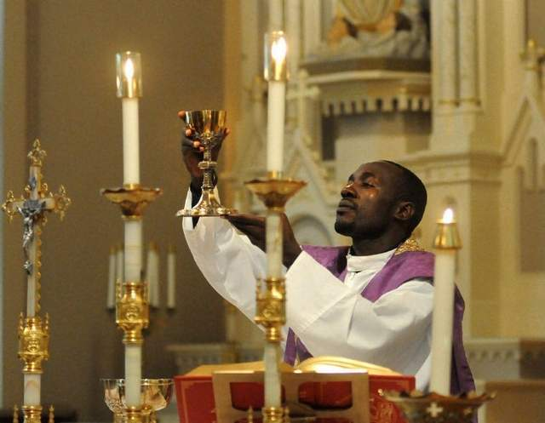

What is ritual?
Rites and ceremonies
a series of actions performed according to a prescribed order

Slide 4
Each group identify one ‘ritual’ in contemporary Singapore.

Slide 5
An anthropological theory of ritual
Symbolic statements about a social order, organization or “identity”
“a commentary on the production process”
Rituals “express the social and cosmological role of the temple” (52)
The symbolism of temple rituals is “sociogenic”

Slide 6

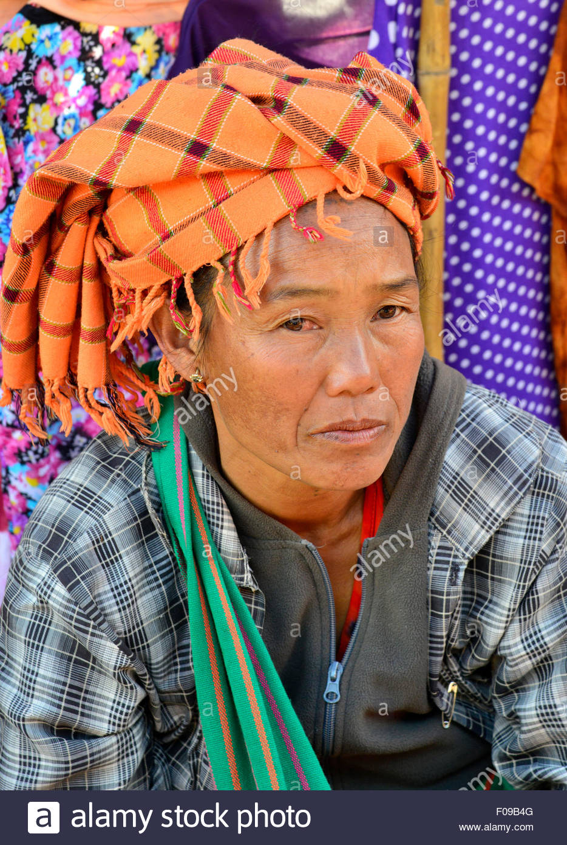
Different rituals, same social ‘meaning’
Source: Edmund Leach, Political Systems of Highland Burma

Slide 7
What is technology?

Slide 8
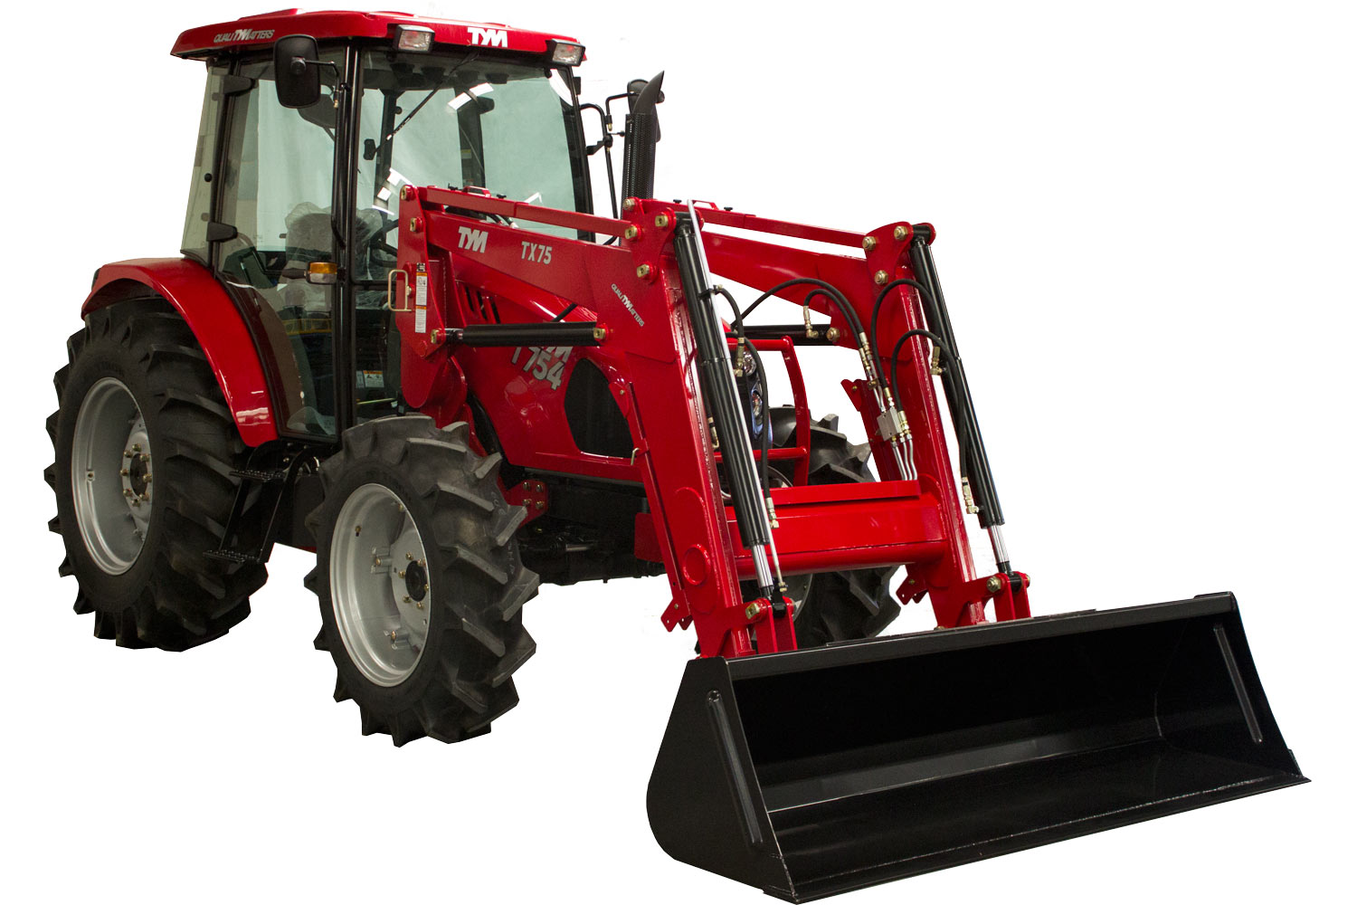

Slide 9
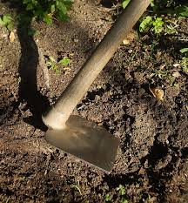

Slide 10
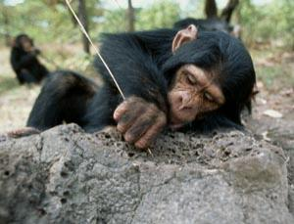

Slide 11
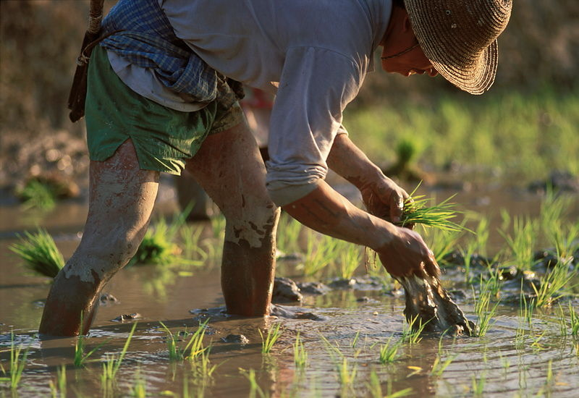

Slide 12
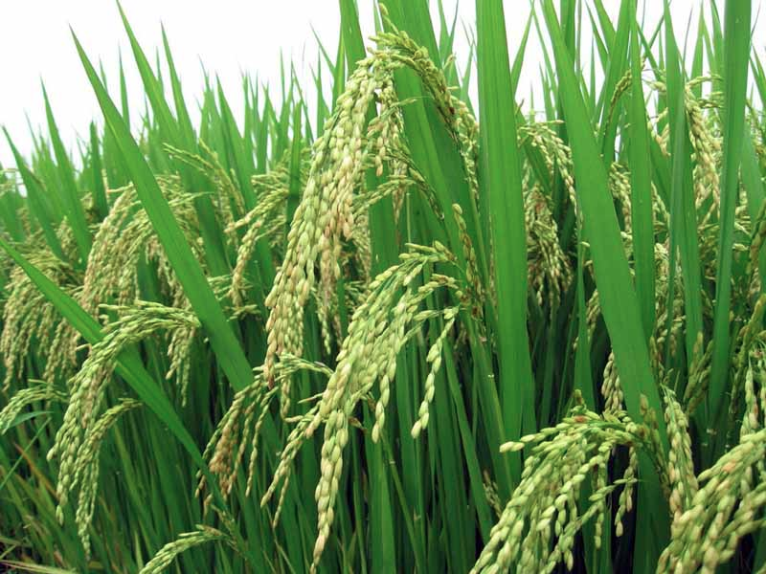

Slide 13
Select one technology that is used in rice cultures.
What makes this a ‘technology’?

Slide 14
Two kinds of technology
Mechanical
Skill-oriented
Is the technology that you chose mechanical or skill-oriented?
Is the water temple system mechanical or skill-oriented technology?

Slide 15
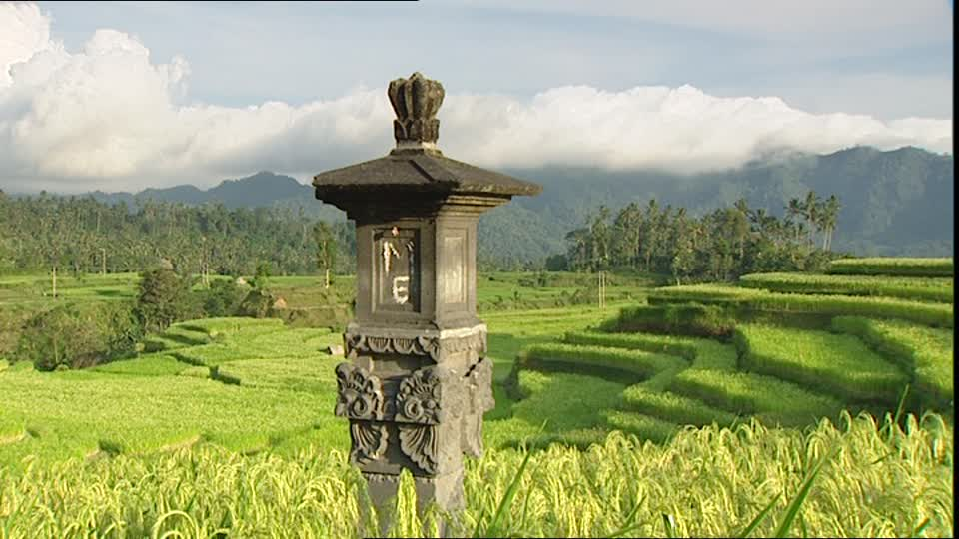
“Temple rituals literally call into existence the task groups that manage the terraces for economic production. . . . In this sense, the temples provide a vehicle to achieve voluntary social cooperation in the management of the irrigation on which each village –and society as a whole—is utterly dependent.”

Slide 16
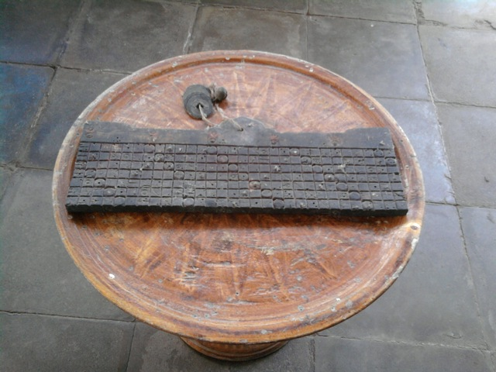
Tika calendar: A ritual technology

Slide 17
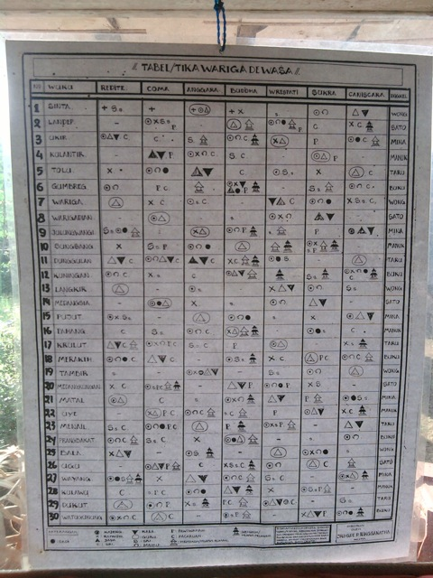

Slide 18
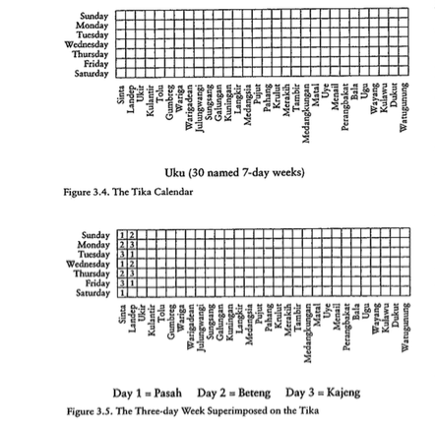

Slide 19
“the annual and agricultural cycles are one and the same”

